Slide 1
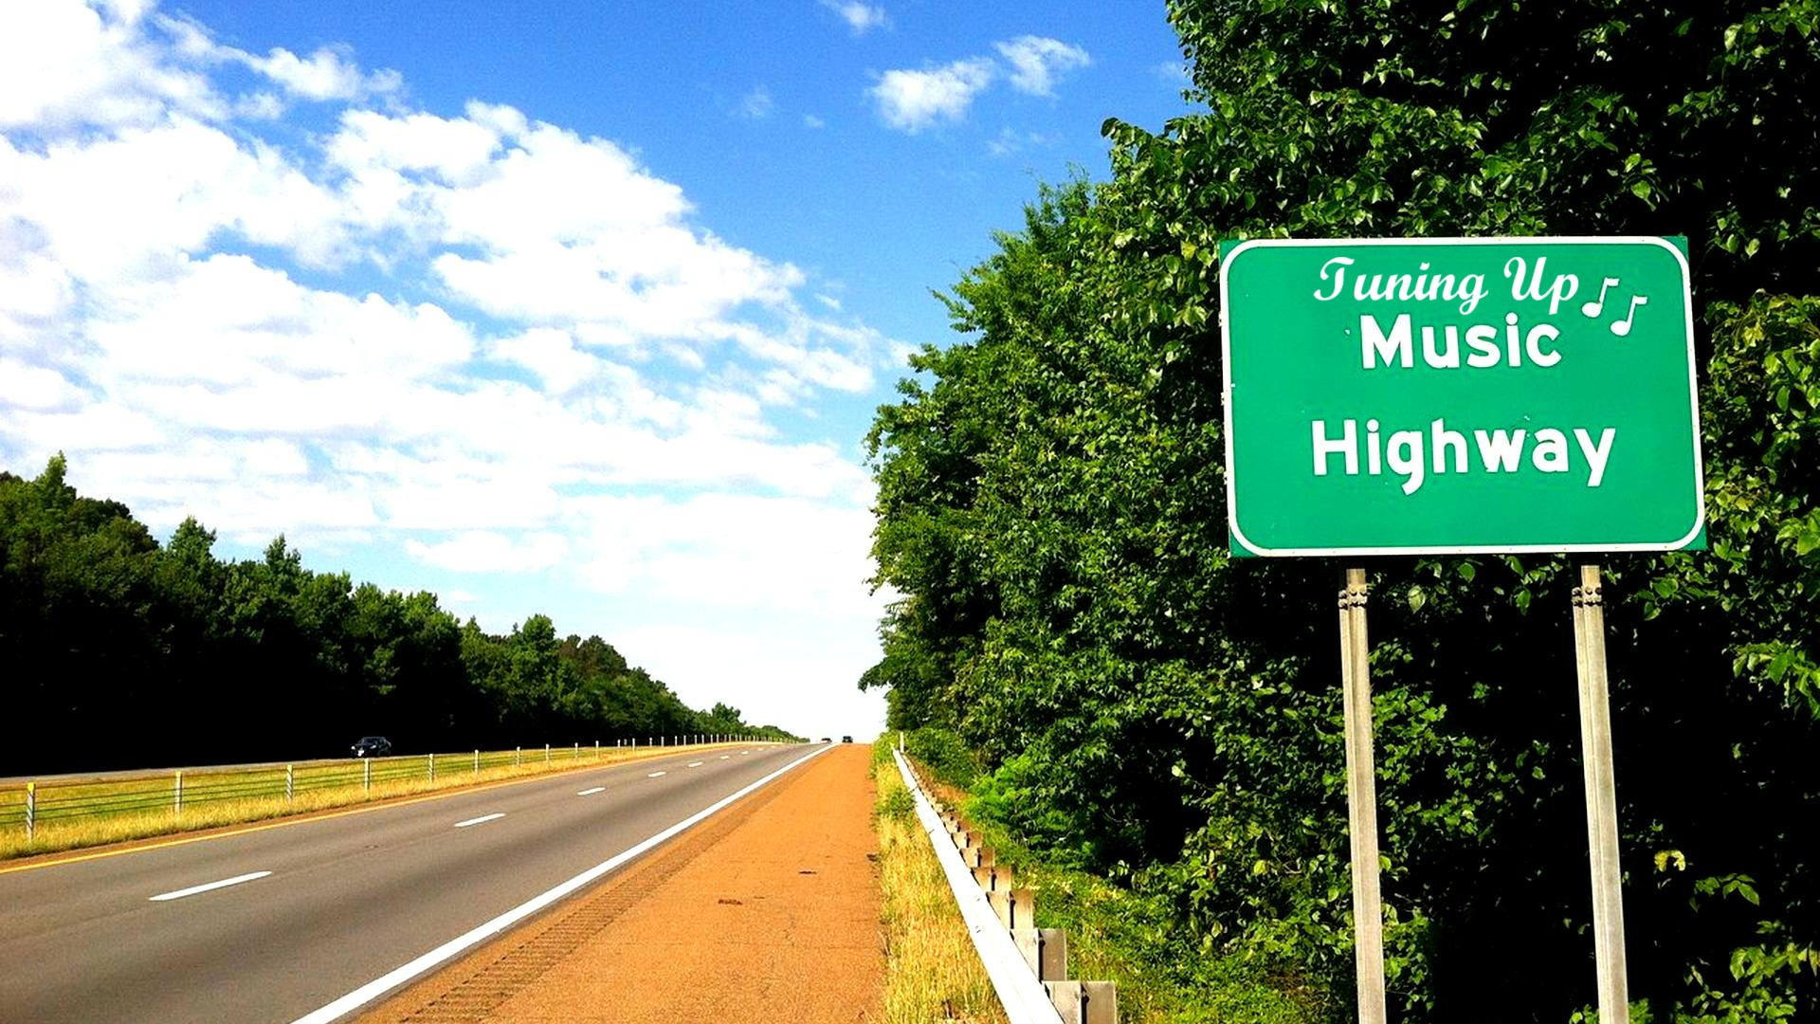
Team Members:
Ruixuan Ding
John Hurtado
Yang Mo
James O’Quinn
Chilambwe Wapamenshi

Slide 2
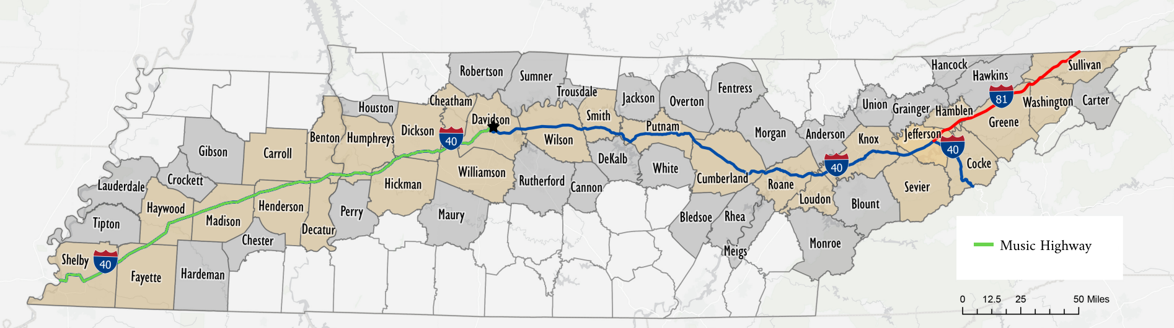
Music Highway

Slide 3
Dataset Generation
Crash Data (2023–2025) from Tennessee DoSHS; focus: I-40 in Madison & Henderson counties
Raw Features: Latitude, longitude, crash severity
Enrichment: Tagged road features (guardrails, lighting, pavement, etc.) via Google Street View
Issue: Class imbalance.
Notes:
“We looked at crash data from 2023 to 2025 in Madison and Henderson counties — spots with a lot of injury crashes. The data came from the Tennessee Department of Safety, but it only gave us the basics: location and severity. So to get more out of it, we manually tagged features like guardrails, lighting, and pavement condition using Google Street View. The dataset ended up being a bit imbalanced in terms of crash severity, but we took that into account when training the model.”

Slide 4
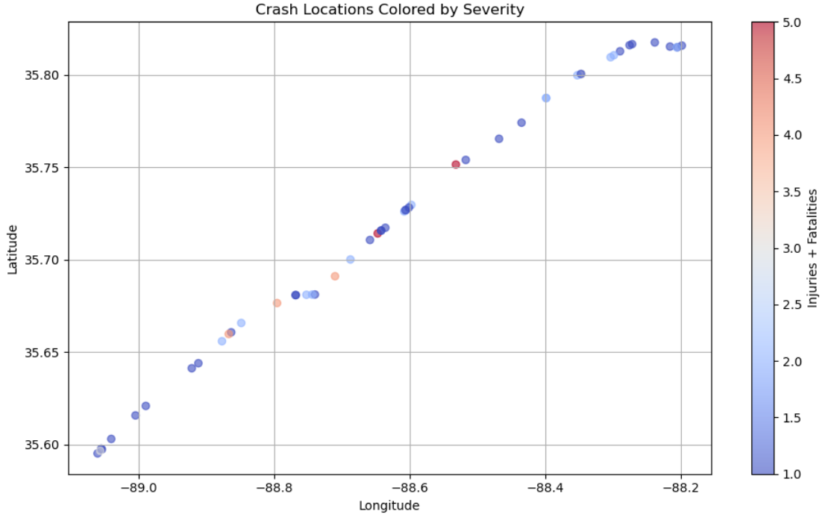
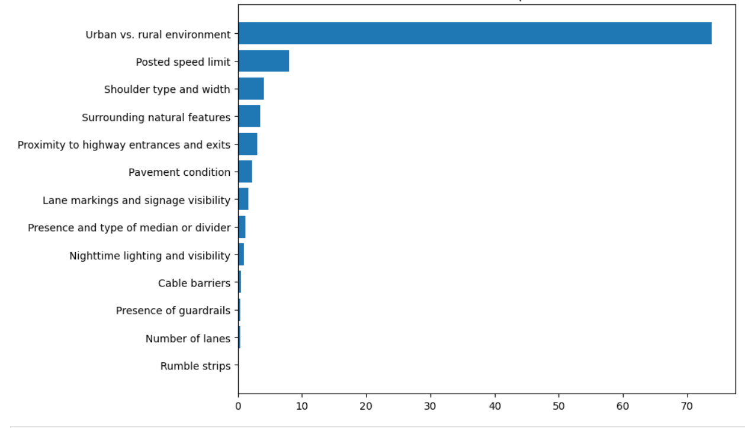
Key Findings from Exploratory Analysis
Crash Severity by Location
Feature Importance

Slide 5
Objective
Evaluate the impact of specific safety interventions on crash severity along I-40 in Madison and Henderson Counties.
Modeling Approach:
Binary target: injury vs. no injury
Held-out segment to simulate interventions
Oversampling to balance data

Slide 6
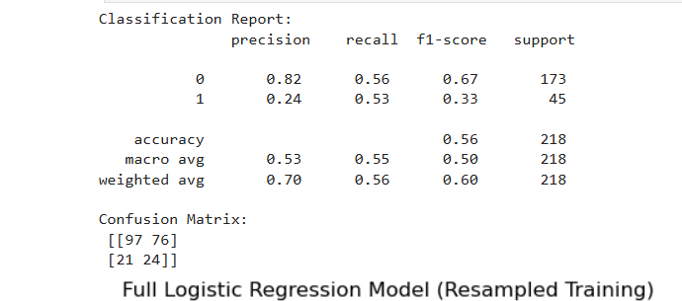
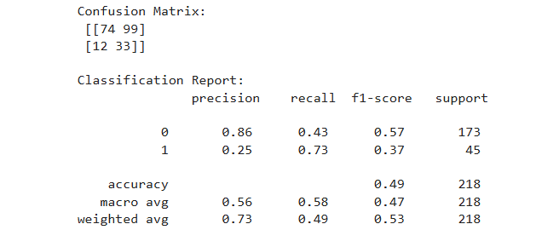
Models Used
Logistic Regression for easy interpretation of feature effects.
CatBoost Classifier for handling complex categorical data efficiently.
Logistic regression model: CatBoost Classifier:

Slide 7
Hypothesis Testing
We simulated each safety intervention by changing the relevant features in the data.
Model predictions before and after these changes were compared to estimate impact.
Statistical significance was tested using bootstrap resampling with 10,000 samples.
The null hypothesis assumed interventions did not change injury rate

Slide 8
Evaluation Metrics
We focused on recall to catch as many injury cases as possible.
F1 score was used to find the best prediction threshold balancing precision and recall.
Significance of intervention effects was confirmed using p-values and confidence intervals.

Slide 9
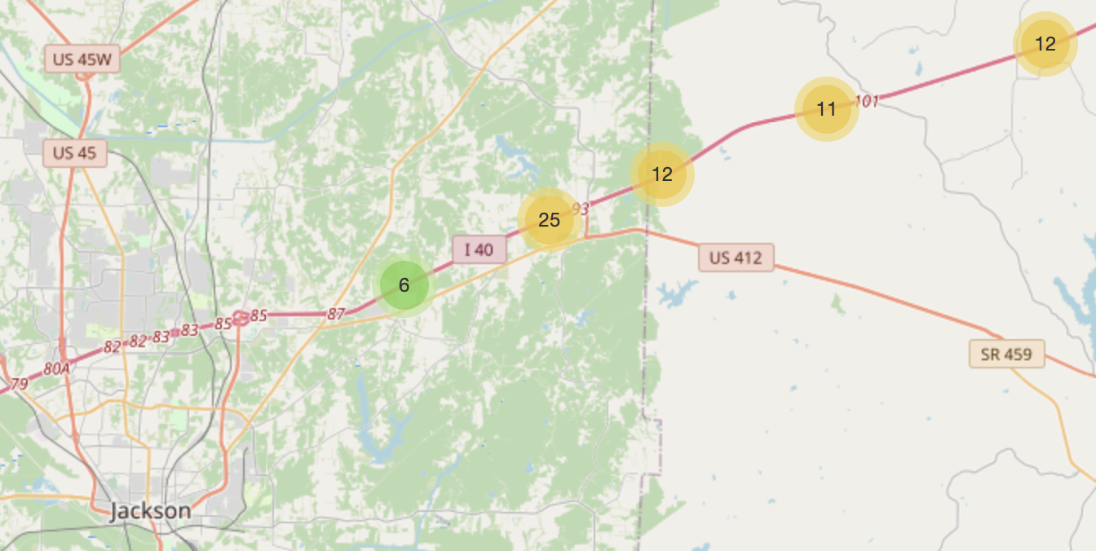
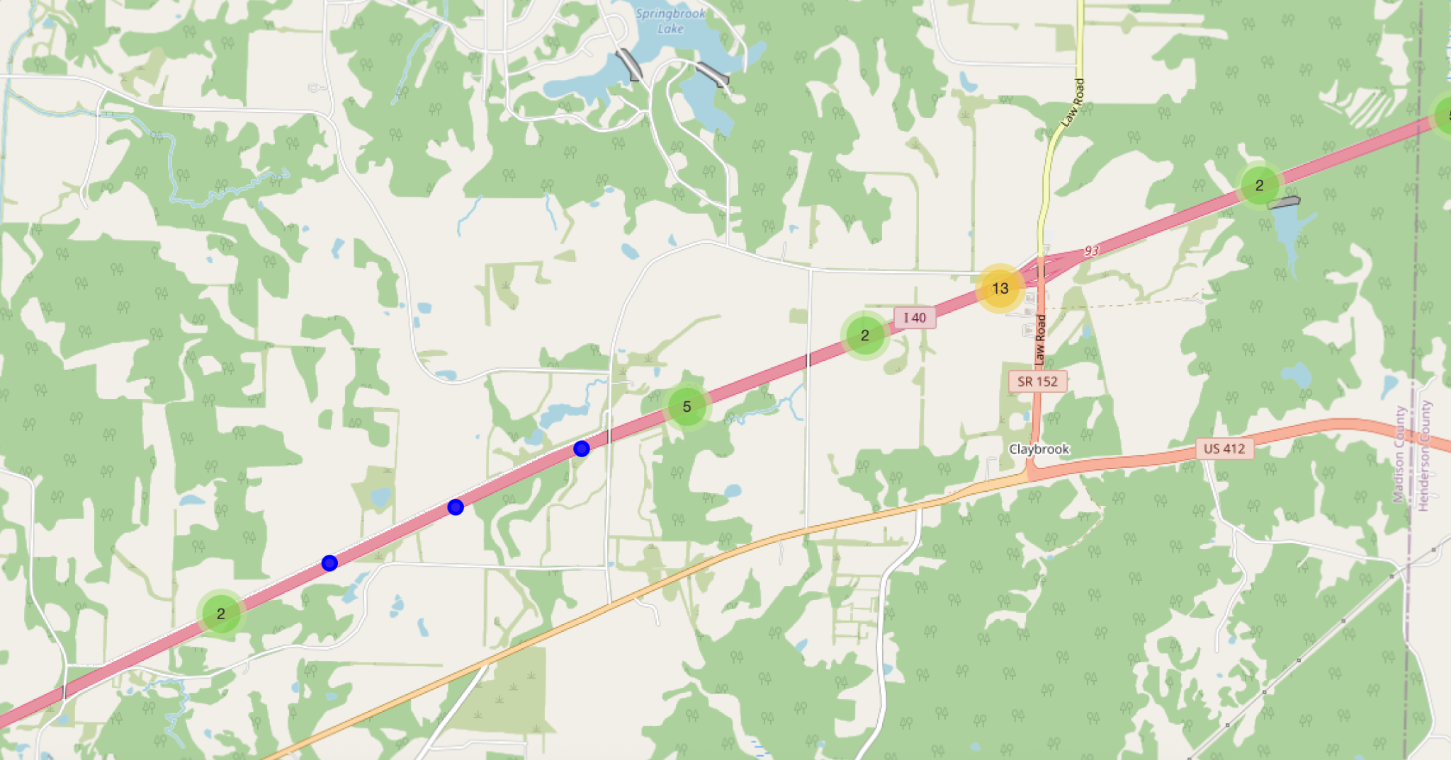
Results
Segment Details
Segment Length: 3.26 miles
Longitude range: (-88.663, -88.605]
Time Period of Observation: 2023–2025
Observed Injurious Crashes (Actual): 25

Slide 10
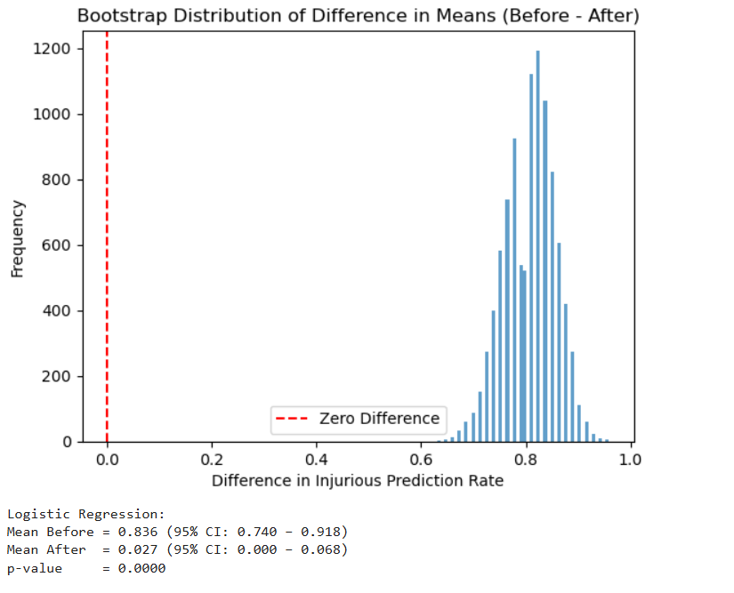
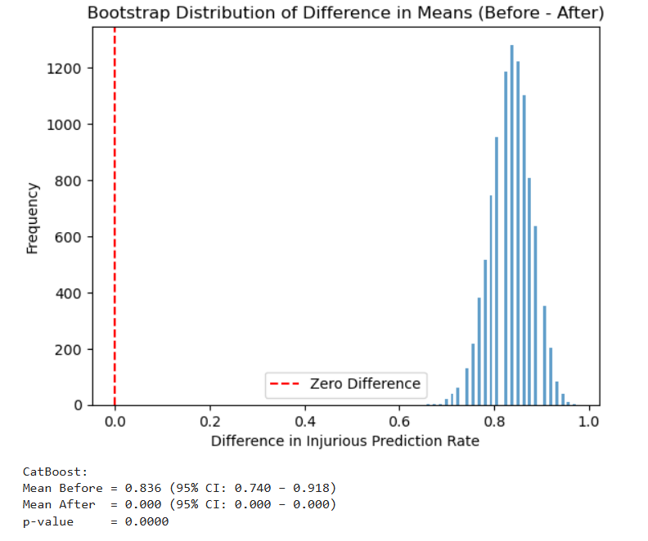
Results

Slide 11
Results
Injury Reduction Predictions
Model | Predicted Before | Predicted After | Reduction
Logistic Regression | 61 | 2 | 59
CatBoost | 61 | 0 | 61
Societal Cost of Injury (Conservative Assumption)
Cost per Injurious Crash | $302,600
Prediction threshold with LR | 50%
Estimated Societal Benefit | 0.5 x 59 x $302,600 = $8,926,700
Source: US Department of Transportation Cost-Benefit Analysis 2022 Update )
Intervention Cost Estimation
Component | Cost per Mile | Segment Length | Total
Guardrails | $ 626,600 | 3.26 miles | $ 2,042,716
Lane Markings & Signage | $ 60,000 | 3.26 miles | $ 195,600
Total Estimated Cost |  |  | $ 2,238,316
Source:FHWA Roadway Design
Net Benefit = $8,926,700 - $2,238,316 = $6,688,384

Slide 12
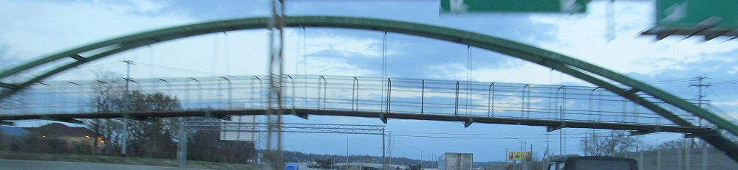
Future Directions:
Causal modeling
Recognizing highway features with deep learning
Investigating crash prevention

Slide 13
